Slide 1
How to work with GitHub
And get the best grade in this subject

Slide 2
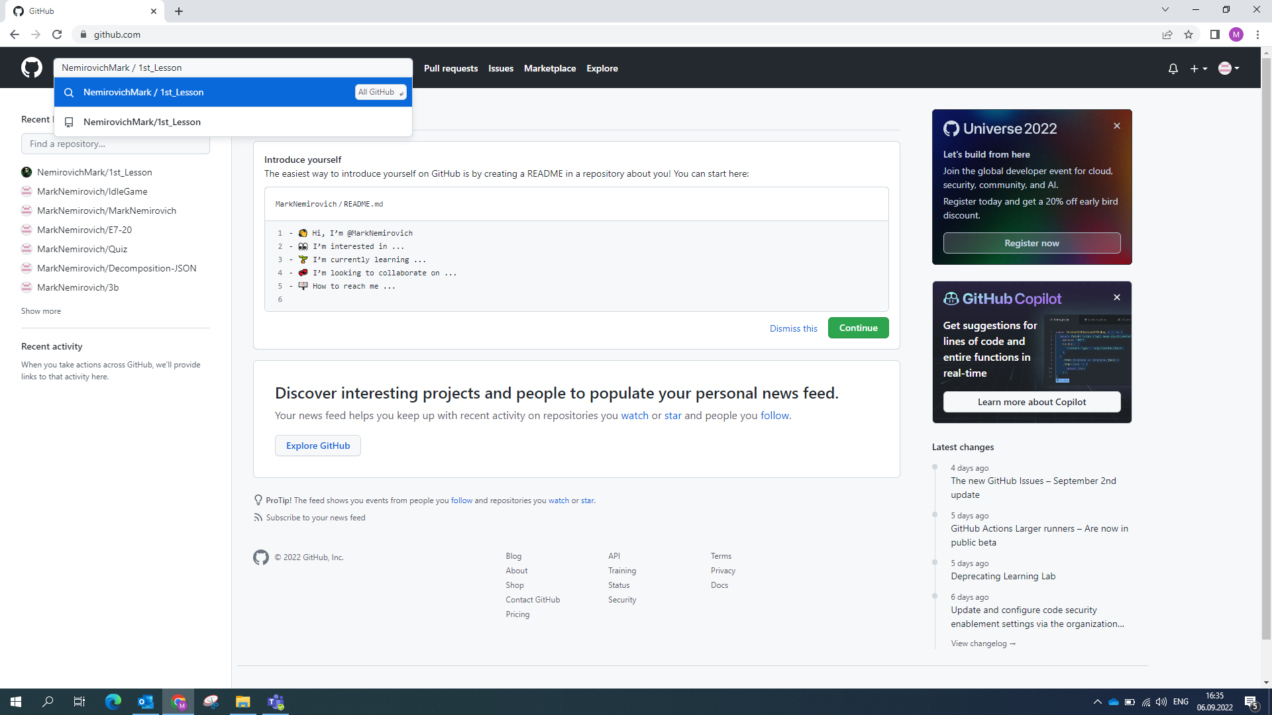
Find the project (or use link I provided in the message)

Slide 3
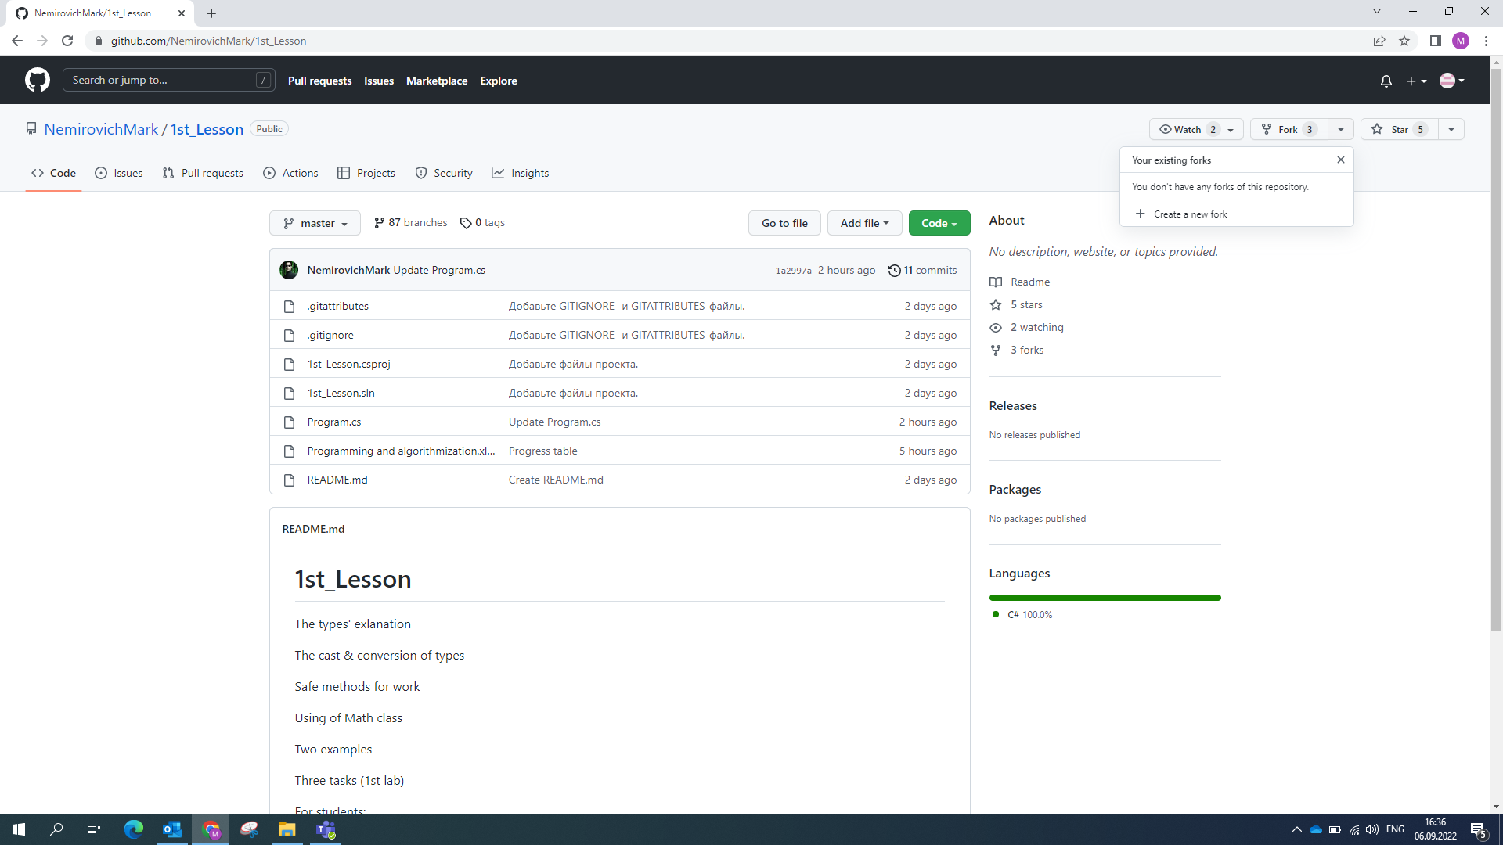
Create a new fork to this project (once each lab)

Slide 4
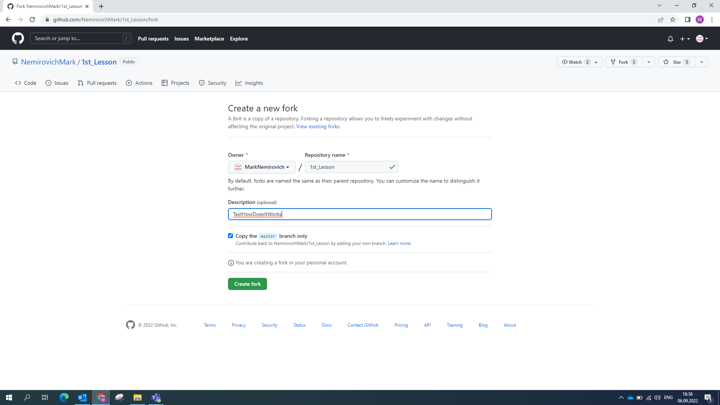
Copy only “master” branch

Slide 5
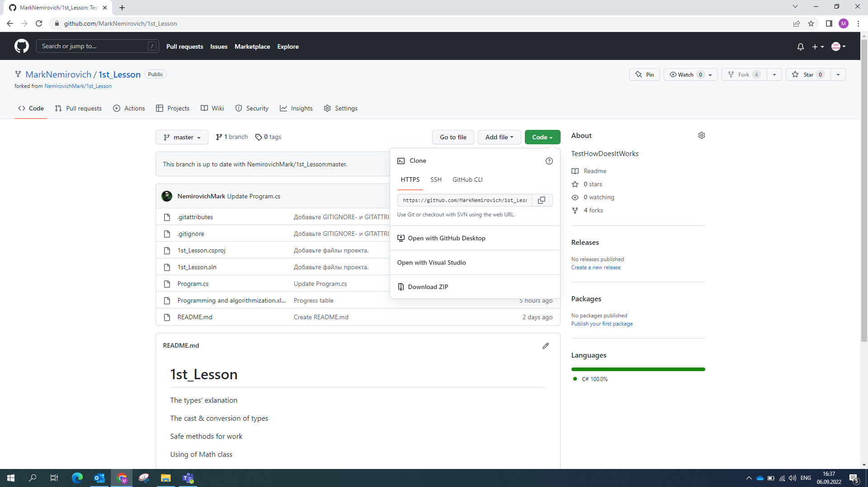
You can open this project in VS or download it, or just copy Program.cs file and change in any editor

Slide 6
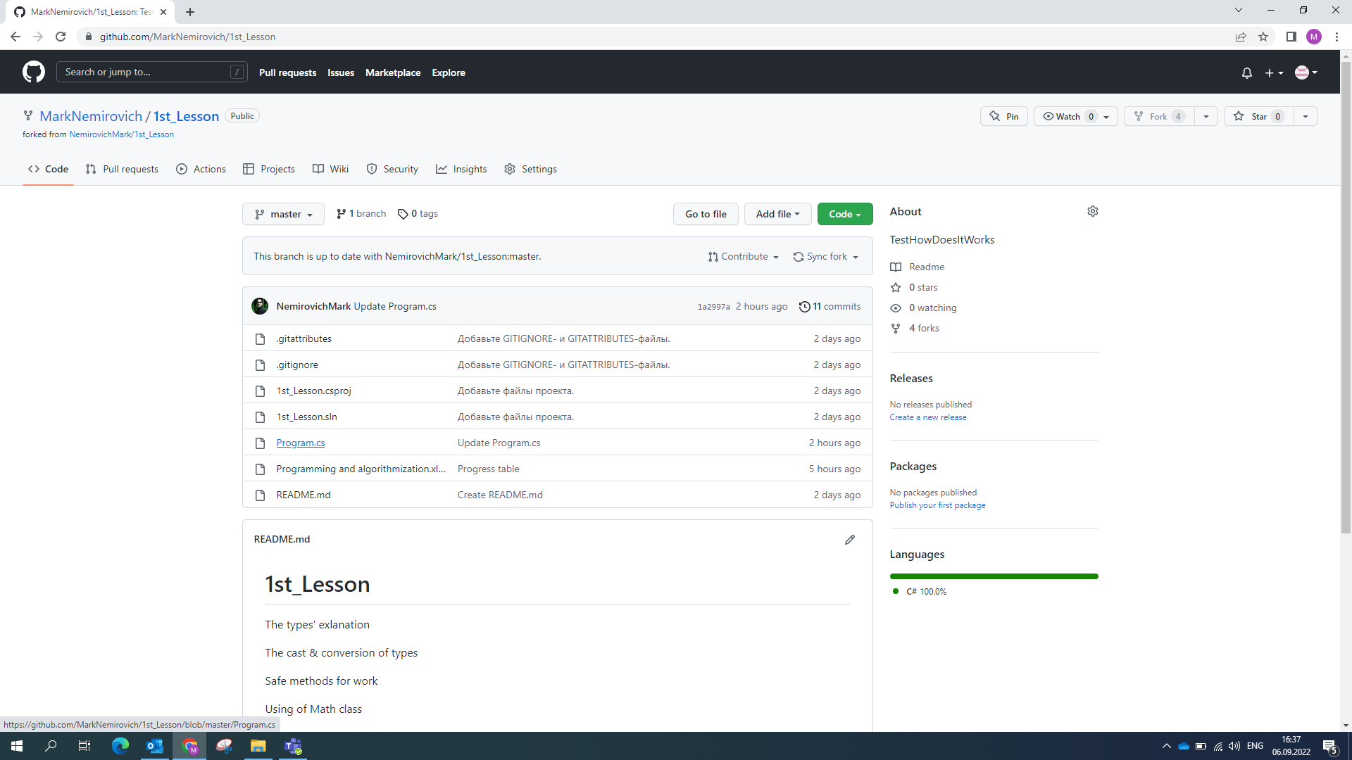
You can even open it here

Slide 7
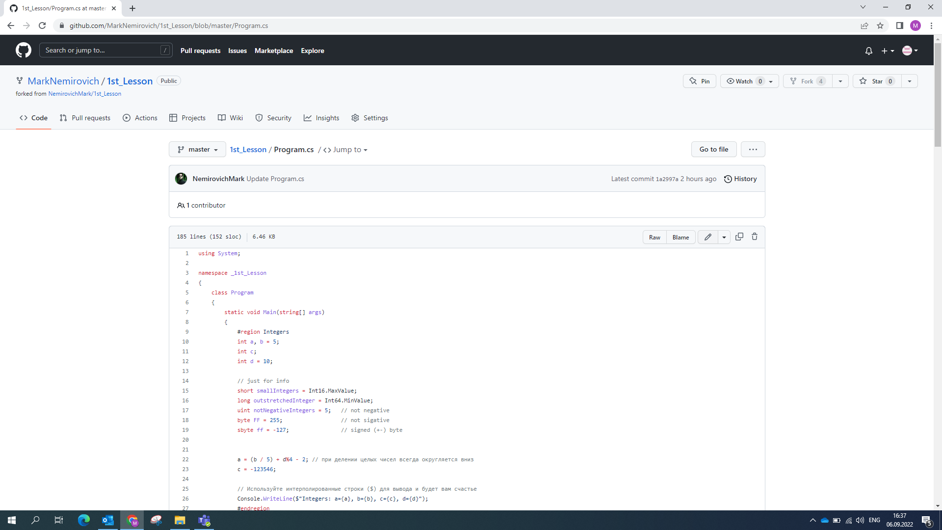
And edit

Slide 8
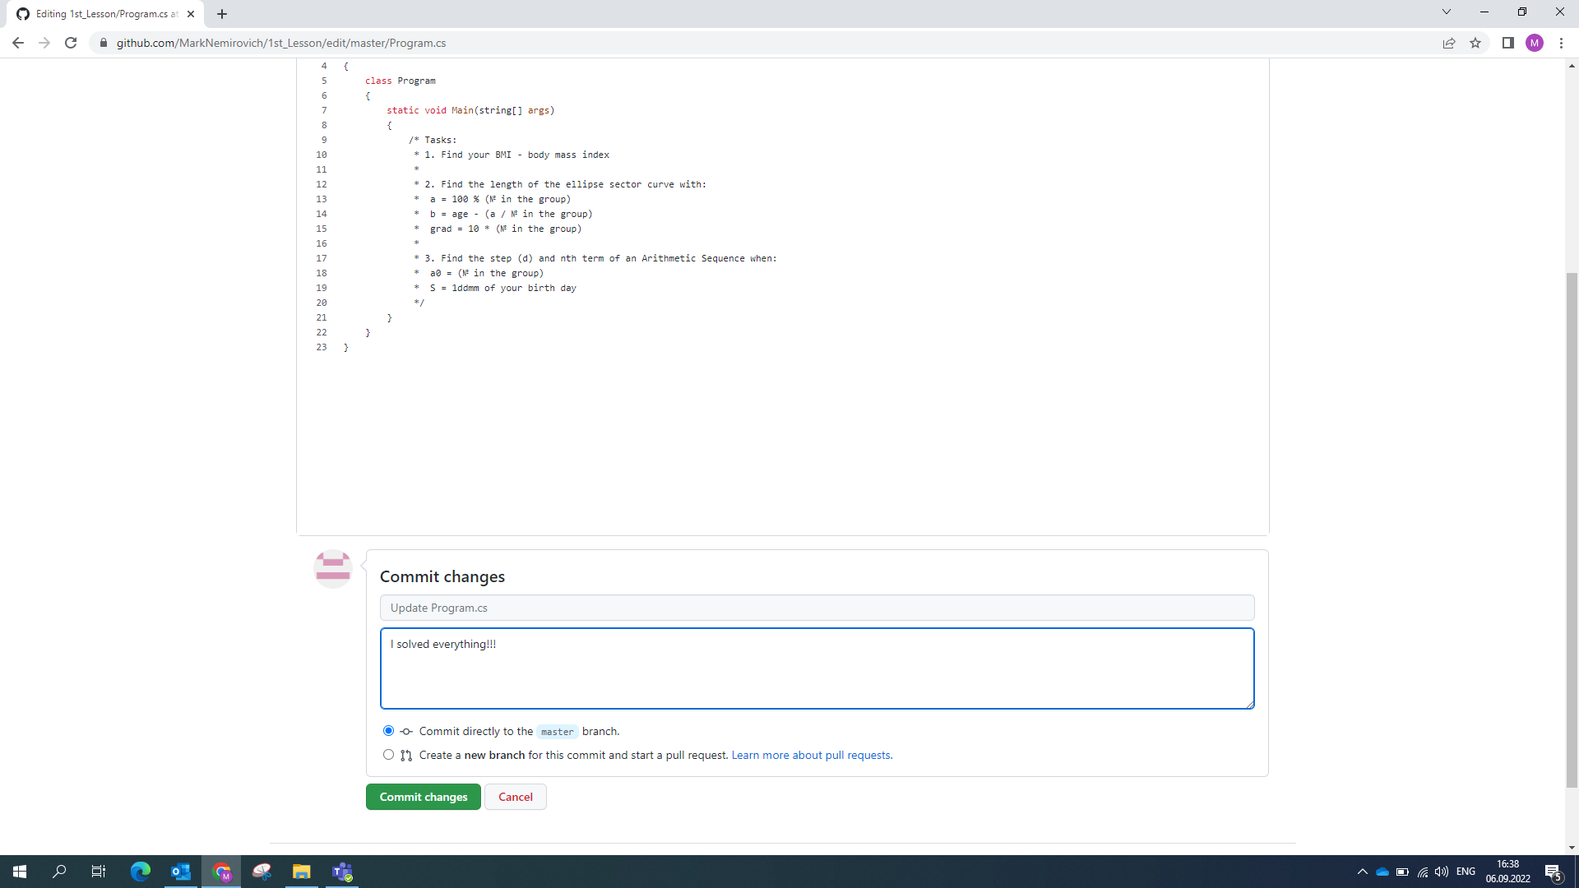
Write here comment for yourself (as a reminder what you did)

Slide 9
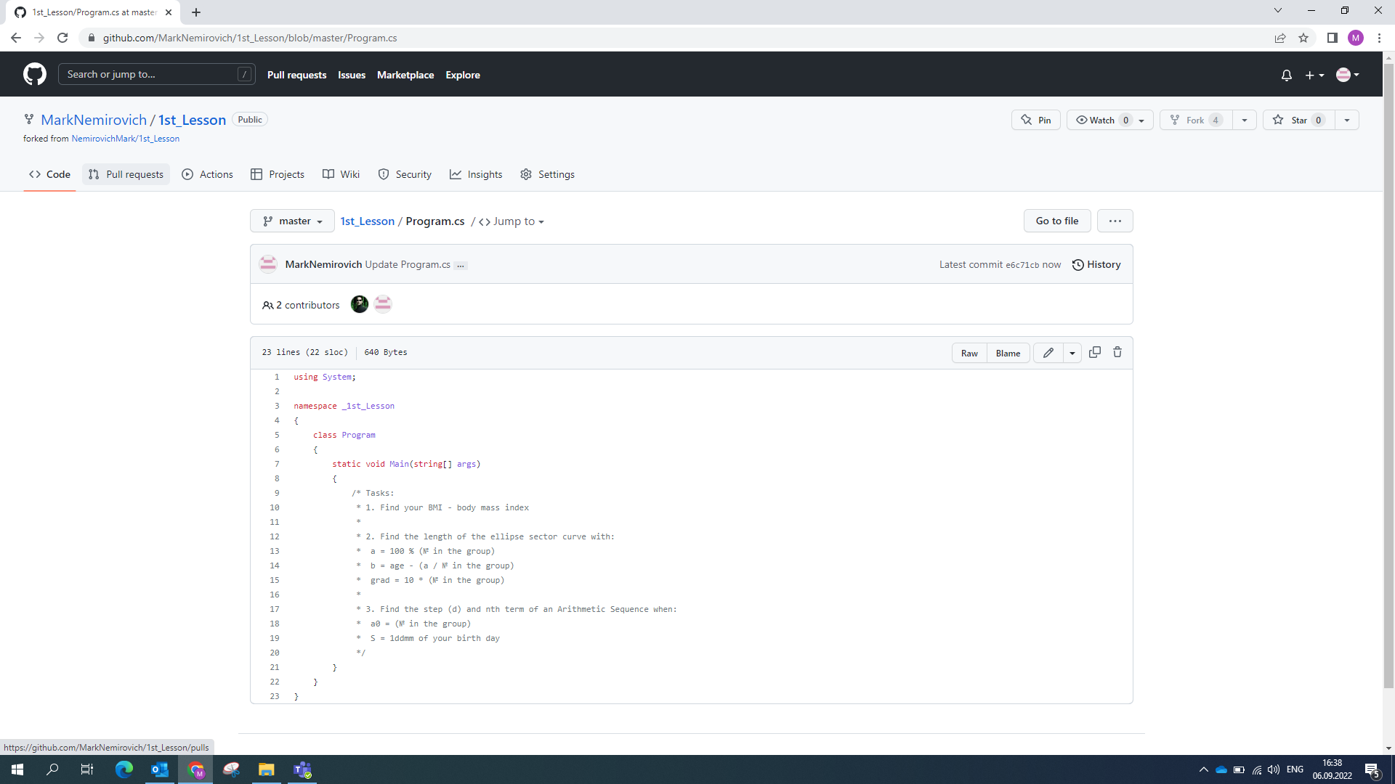
Then, go to Pull requests for send

Slide 10
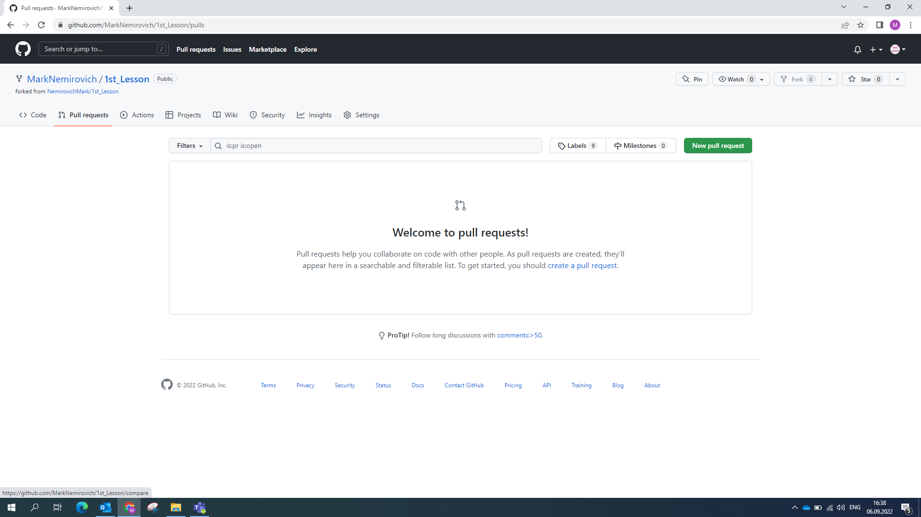
Create new request (or open closed by me)

Slide 11
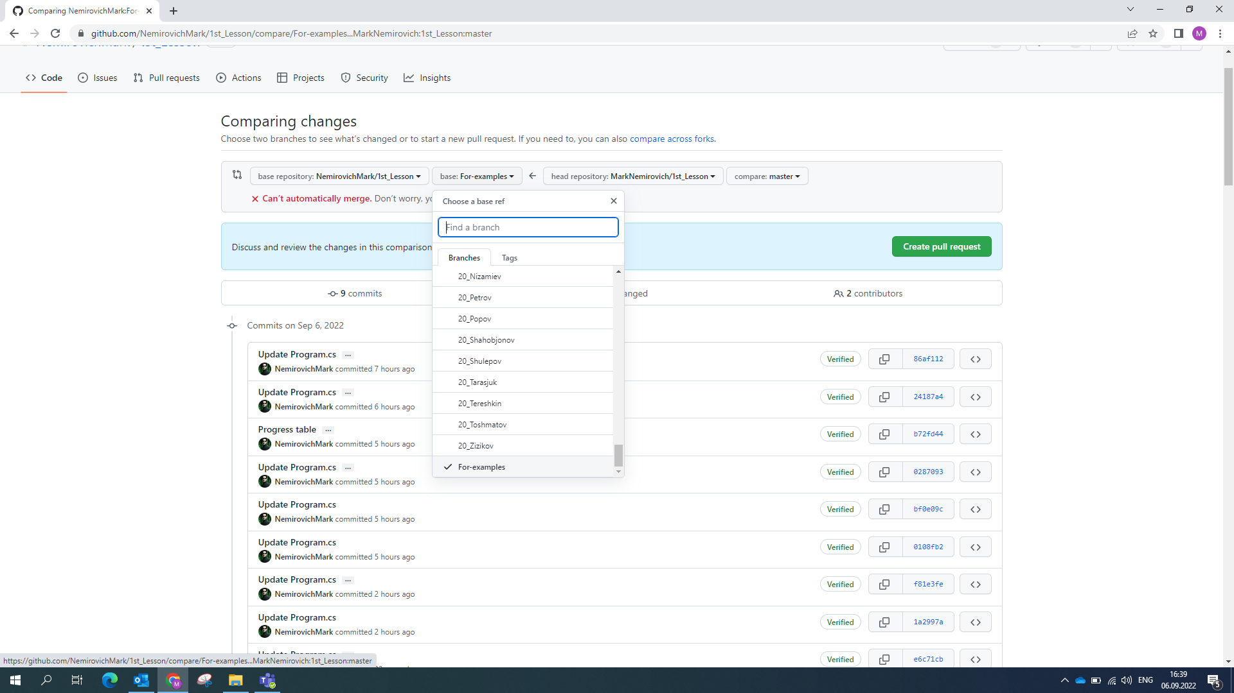
Choose your branch(!) type your surname

Slide 12
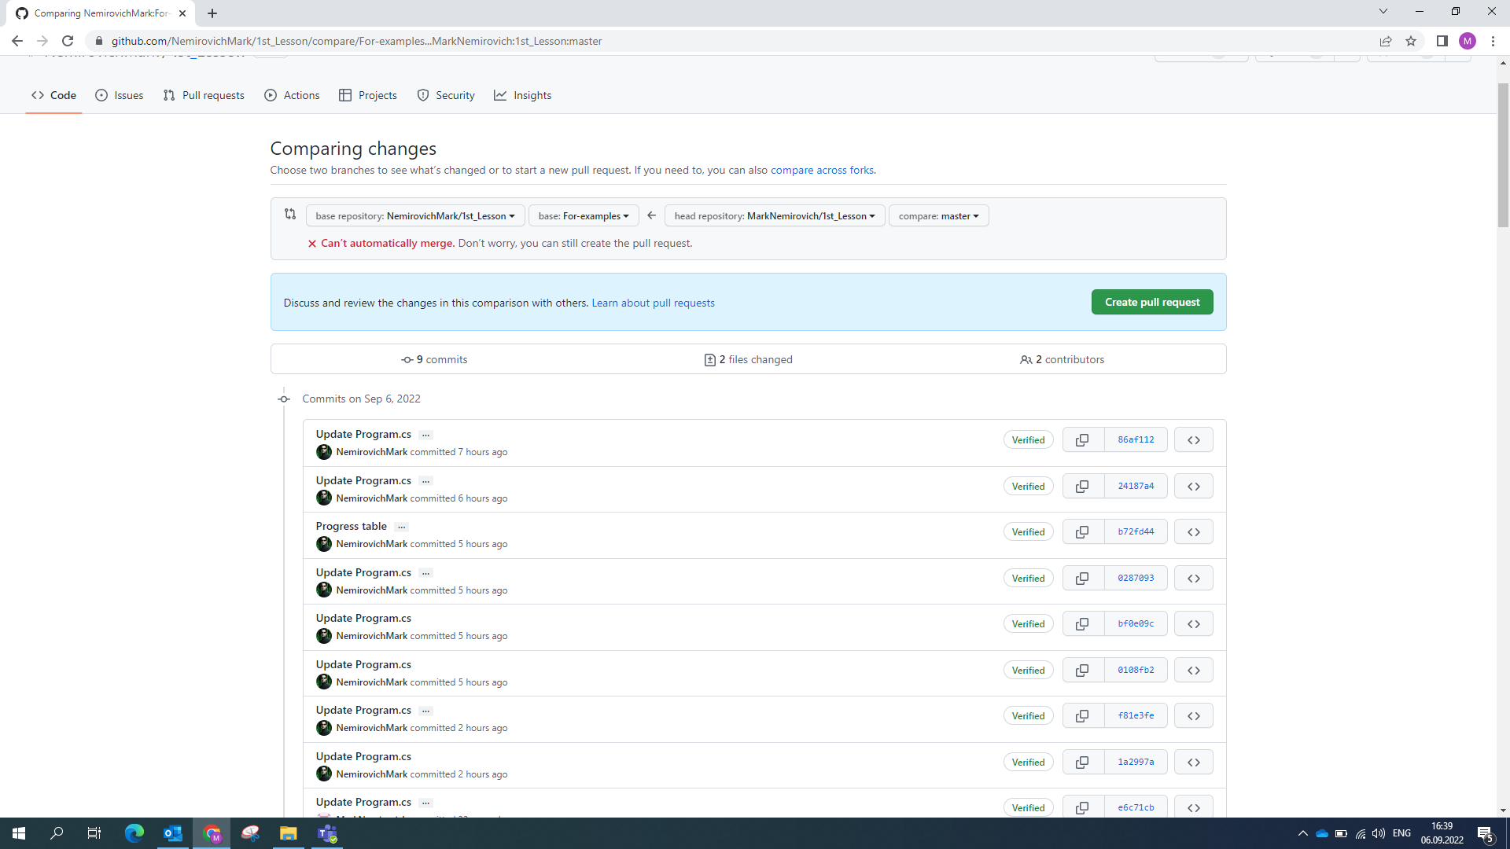
Then create a request

Slide 13
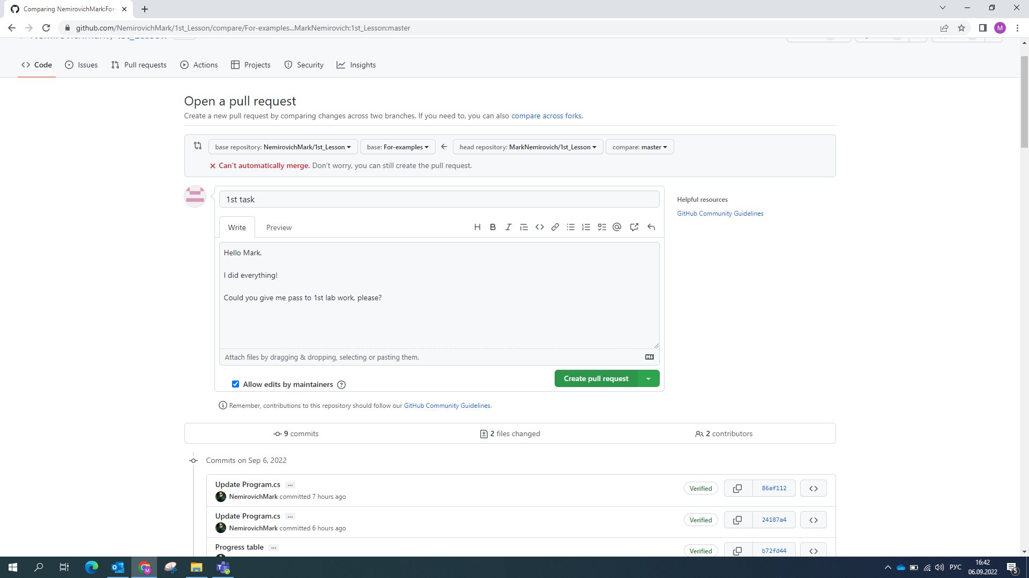
Write here what you did

Slide 14
Good luck!
and may the Google be with you ☺

